Slide 1

JEDI Group-7 Presentation
COURSE REGISTRATION SYSTEM

Slide 2
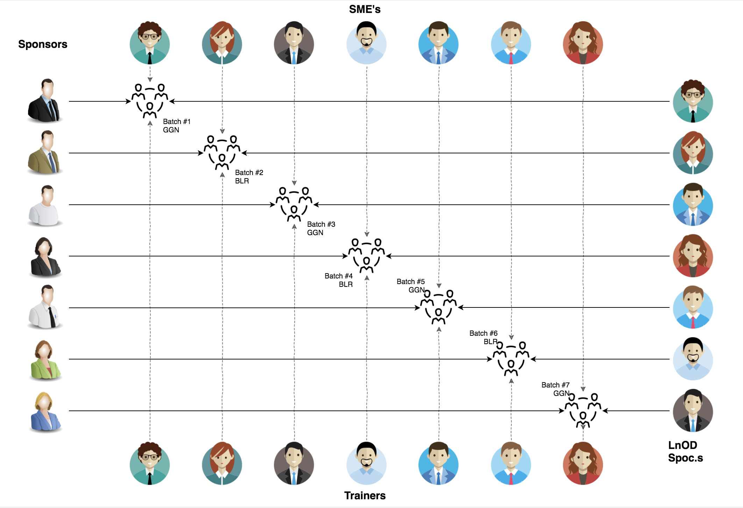
Stakeholders
Sponsors
Flipkart
SME’s
Amit Balyan
Coordinator
Deepika Gajaraj
Shree Laxmi
Notes:
2 min

Slide 3

The Agenda
01
Our Journey
02
Our Team
03
Team Structure
04
Problem Statement
05
Engineering Practices
06
Tech Stack
07
Development
08
Challenges & Learnings
09
Demo
Notes:
Time – 1 min

Slide 4

Our Journey
Notes:
Time - 2 mins

Slide 5
ACTION PLAN
 | Modules | Description
Week1 | UNIX GIT UML Diagrams | Understanding Unix and Git commands Making a git repository and start working through it. Requirement understanding and UML diagram design
Week2 | Java 8 features Interfaces Collections Exceptions Packages SQL Logger Jersey and DropWizard | Developing a POS Application using Java and MySQL Understanding Java 8 features and collections REST API Development using Jersey and DropWizard framework

Slide 6
2 WEEKS OF TRAINING + PROJECT CRS
GOAL
14 DAYS
128 HOURS
7680 MINUTES
460,800 SECONDS
LIMITLESS KNOWLEDGE

Slide 7

Our Team

Slide 8
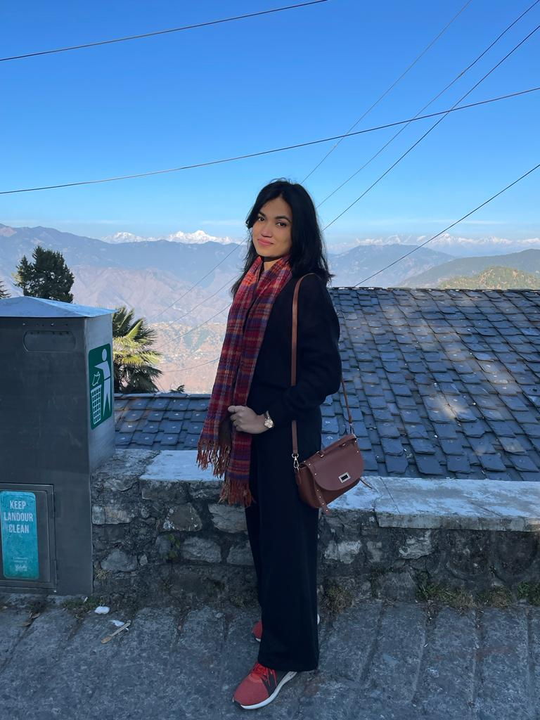
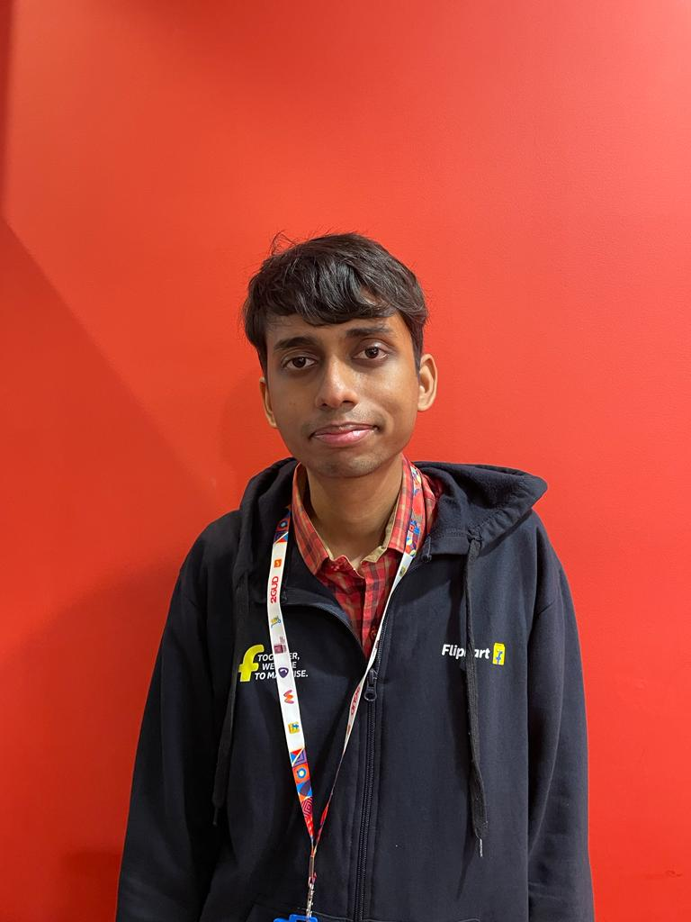
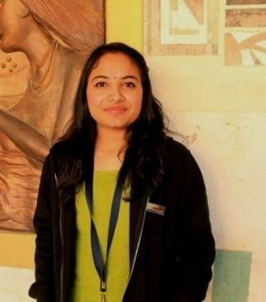
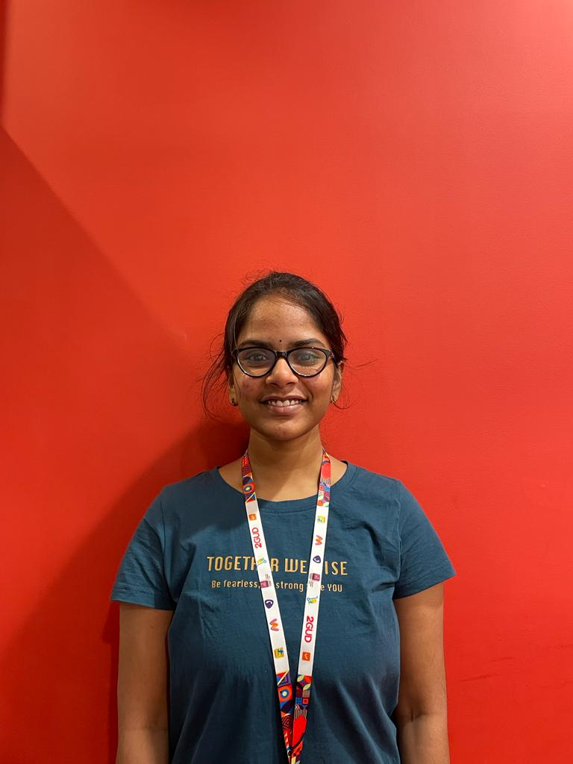
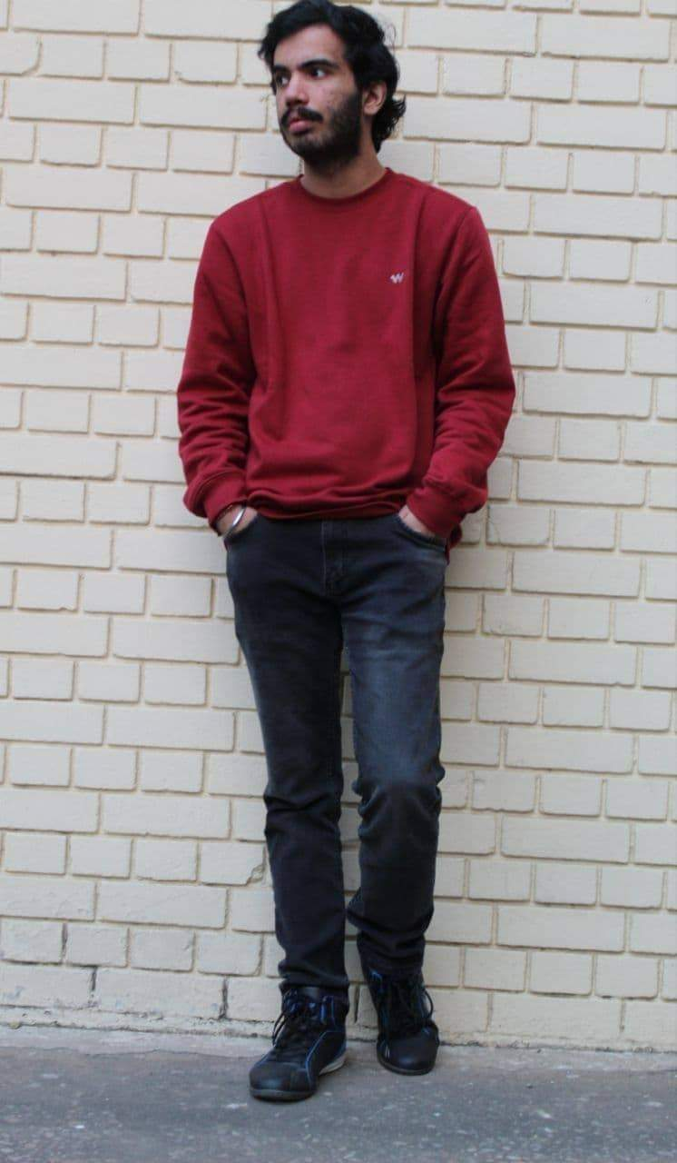
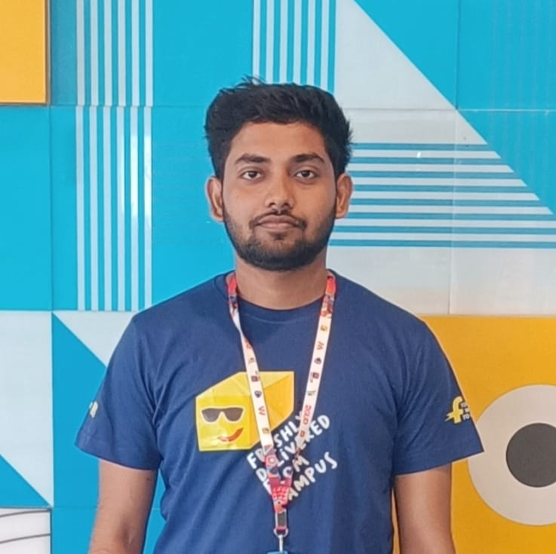
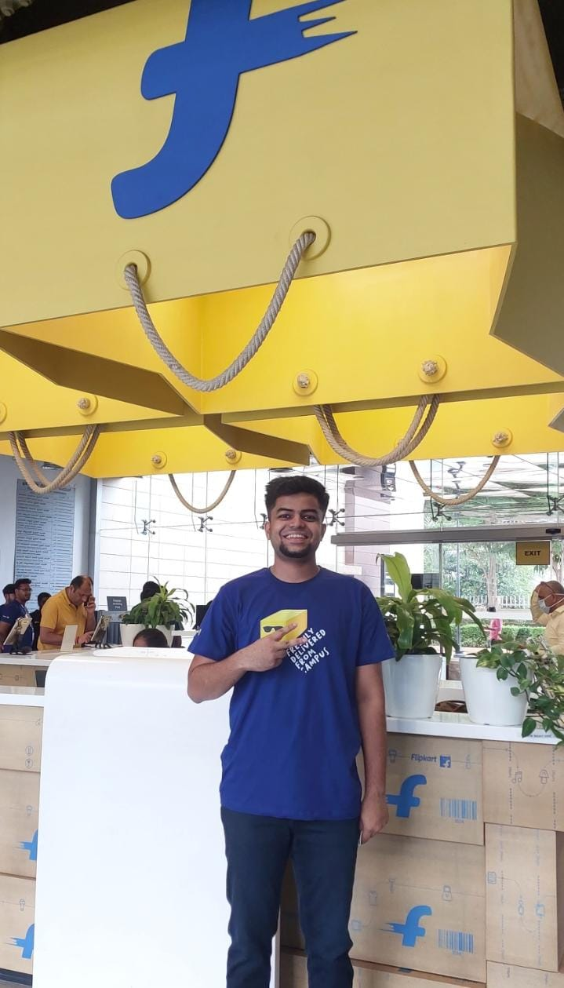
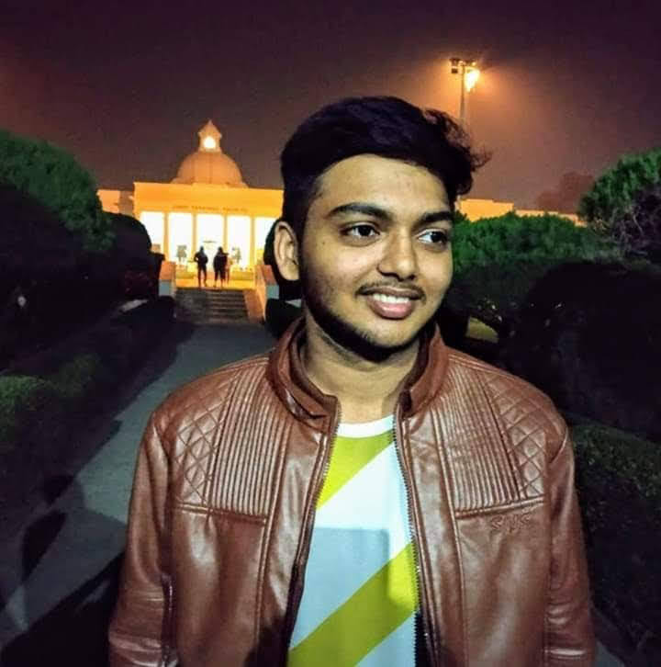
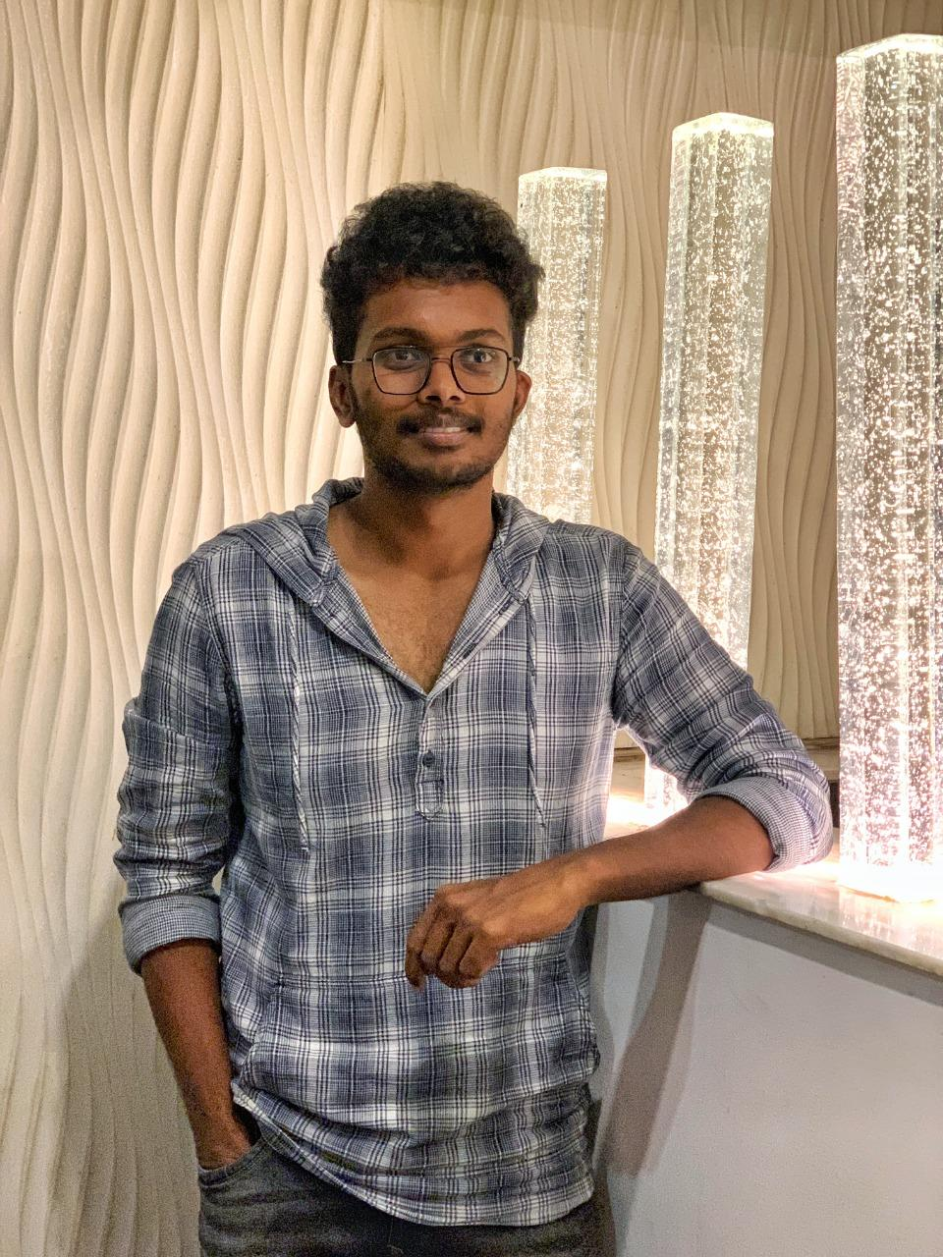
Prachi Bajpai
Team Leader
Akashdeep singh
Kanishka gupta
Meruva Anusha
Vivek Sadineni
SANIDHYA SINGH
Shaurrya lakhanpal
RAVURI DHANUSH
AYUSH MAHAJAN

Slide 9

Project Goals
Notes:
Time – 3 mins

Slide 10




Our Vision
1
2
To create a Course Registration System that allows students to carry out their semester registration, professors to work on Course related activities and the admin to monitor the whole application.
Quality
Security
3
4
Interactivity
Speed
Notes:
User satisfaction and brand value

Slide 11

Engineering Practices
Notes:
Time – 5 mins

Slide 12
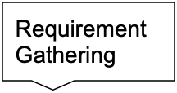
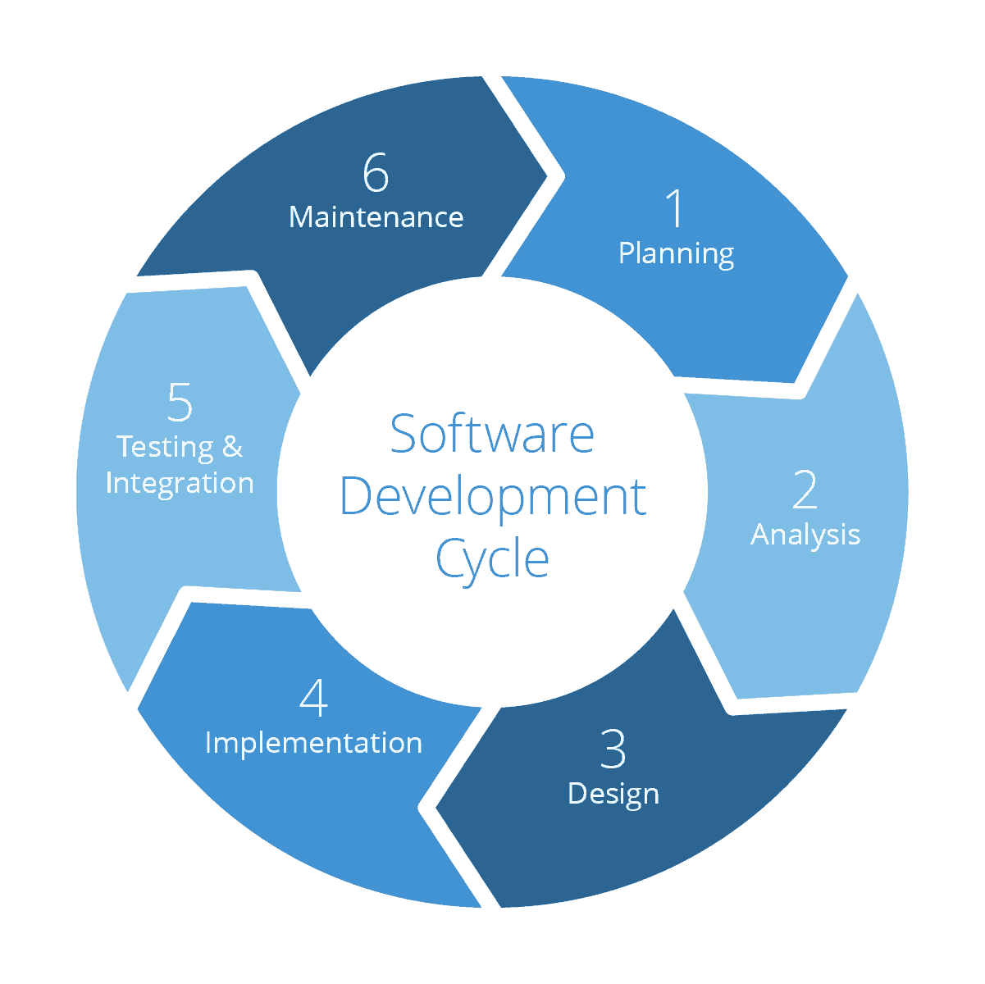
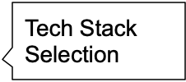

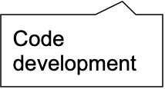

Slide 13

Tech Stack
Notes:
Time – 2 mins

Slide 14















Designing
Backend
Testing
Data
Develop
UML
Core Language
Tools
SQL Database
Code Collaboration
Framework
SQL Workbench
Application Server
IDE
Build System
Notes:
Time – 1 min

Slide 15

Development
Notes:
Time – 1 min

Slide 16
Demo
Testing
Process
5
Project
Demo
Tools
4
Testing on Console, REST client such as Postman
Comprehend
3
Architecture Design and Development
2
Deciding the Technology stack for console and REST API development
1
Understanding Project Requirements and goals

Slide 17

System Architecture
POS Application
Client Layer
Business Layer
Data Access Layer
DATA
HTTP Request
HTTP Response

Slide 18

Challenges & Learnings
Notes:
Time – 2 mins

Slide 19
Challenges and Learnings
 | Challenges | Learnings
Week1 | Understanding the client requirements, i.e., problem statement. Coming up with convincing UML Diagrams | UNIX GIT UML Diagrams
Week2 | Installation of various softwares in multiple environments. POS application development using the specified layered architecture. Collaboration issues such as merge conflicts in Git Migration from POS application to RESTful api’s Jersey validation | Core Java 8 OOPs Concepts MySQL REST API development using Jersey and DropWizard Maven

Slide 20

UML Diagrams
Git Repo Link- https://github.com/prachibajpai01/CRS-Flipkart-REPO-Group7/tree/main/CRS-Group-7-Flipkart-UML-Artifacts

Slide 21
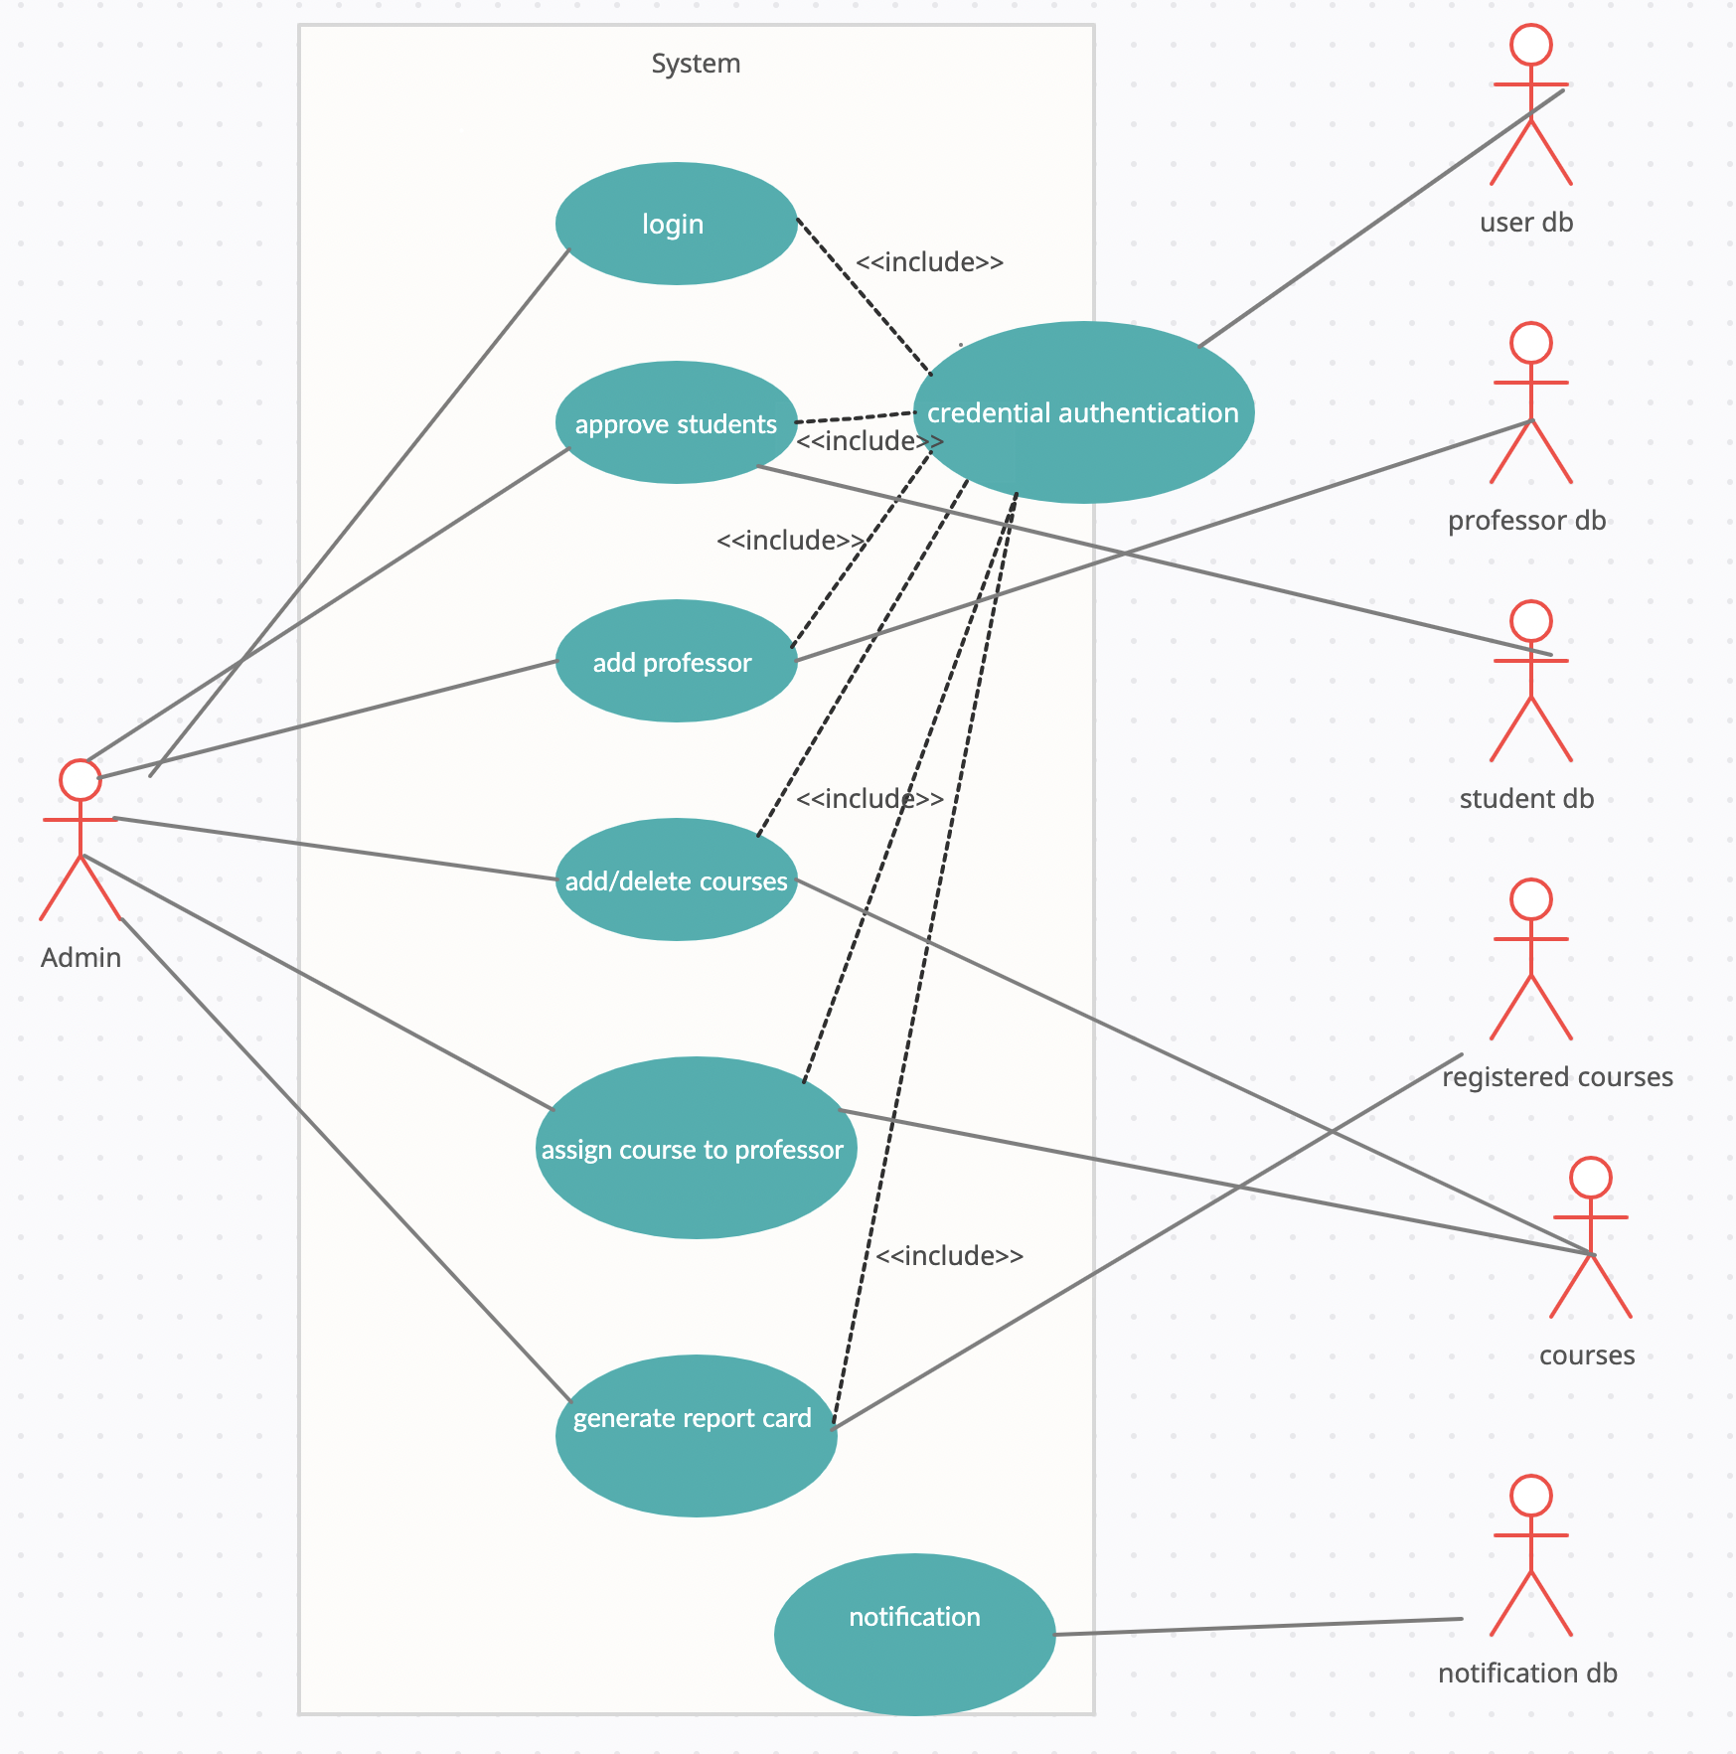
Admin Usecase Diagram

Slide 22
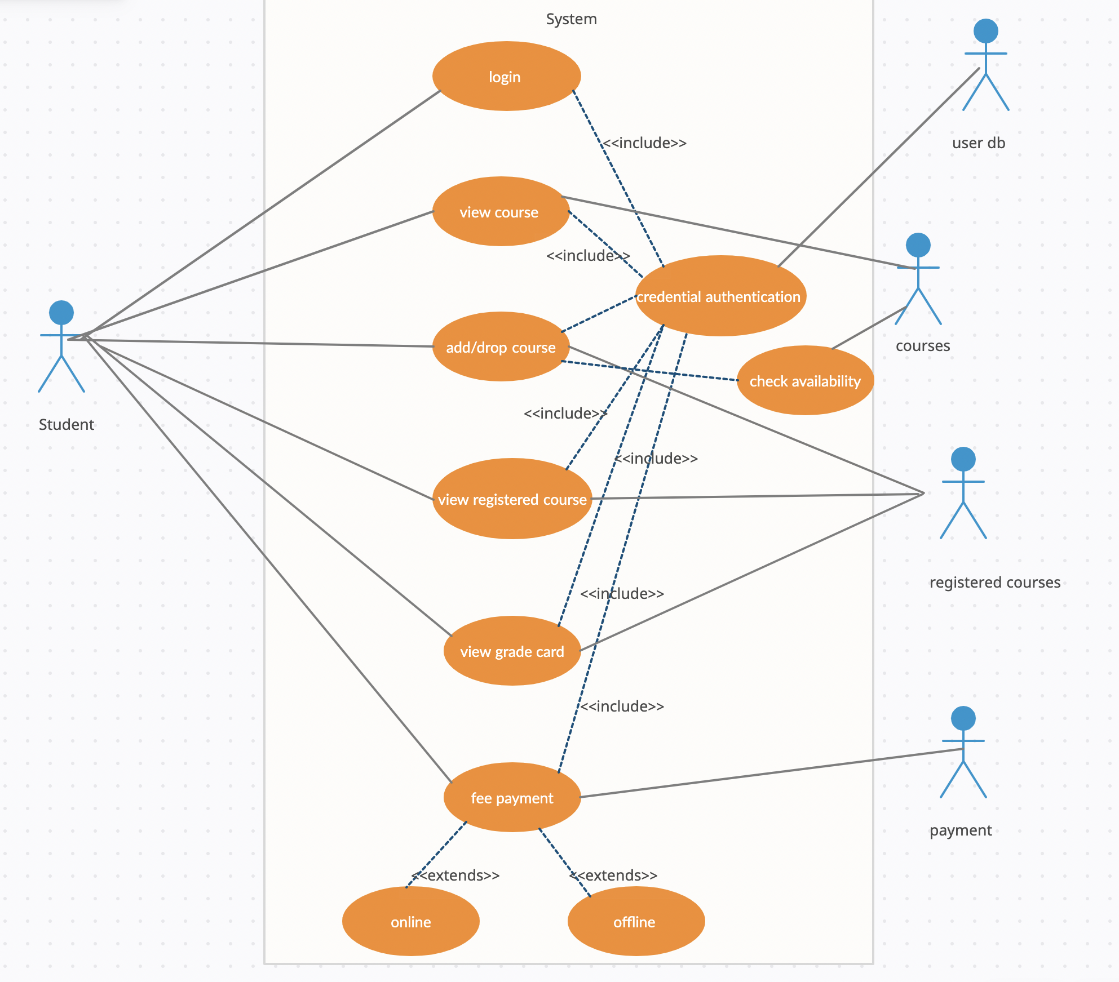
Student Usecase Diagram

Slide 23
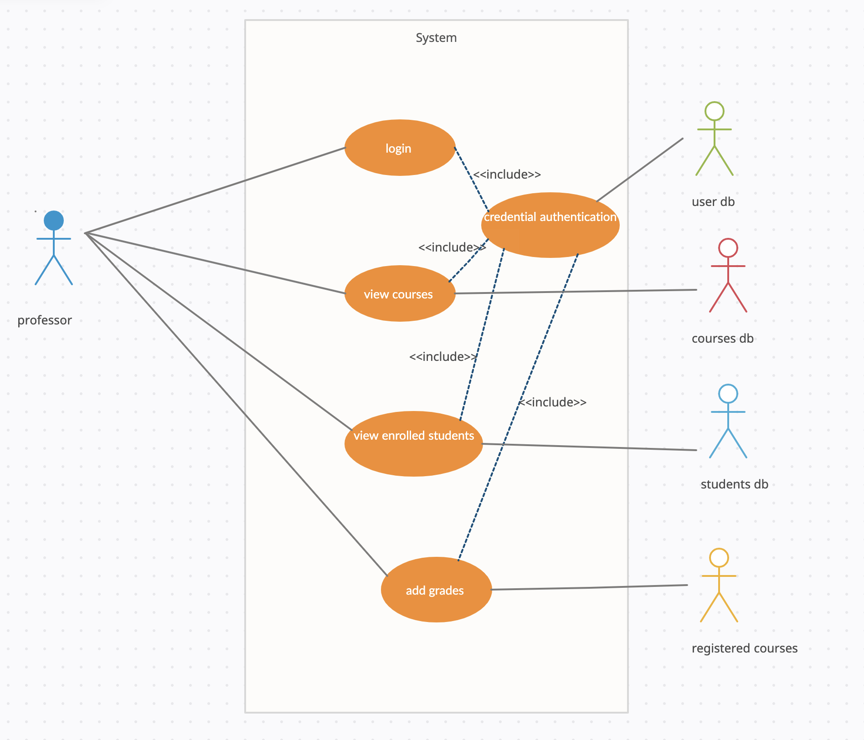
Professor Usecase Diagram

Slide 24
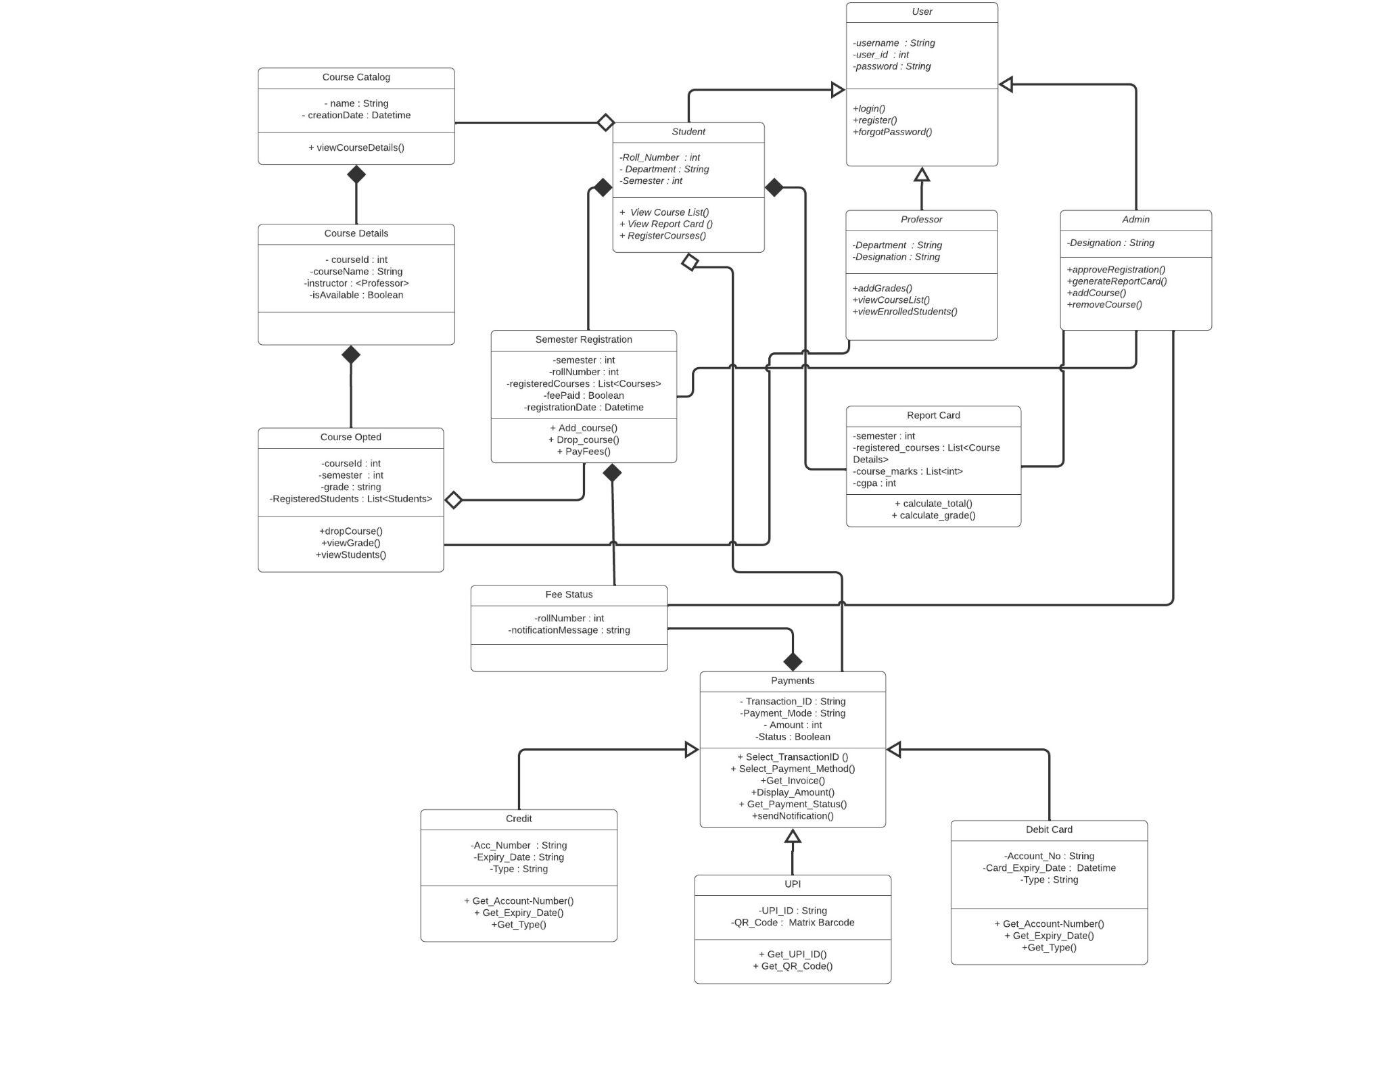
Class Diagram

Slide 25
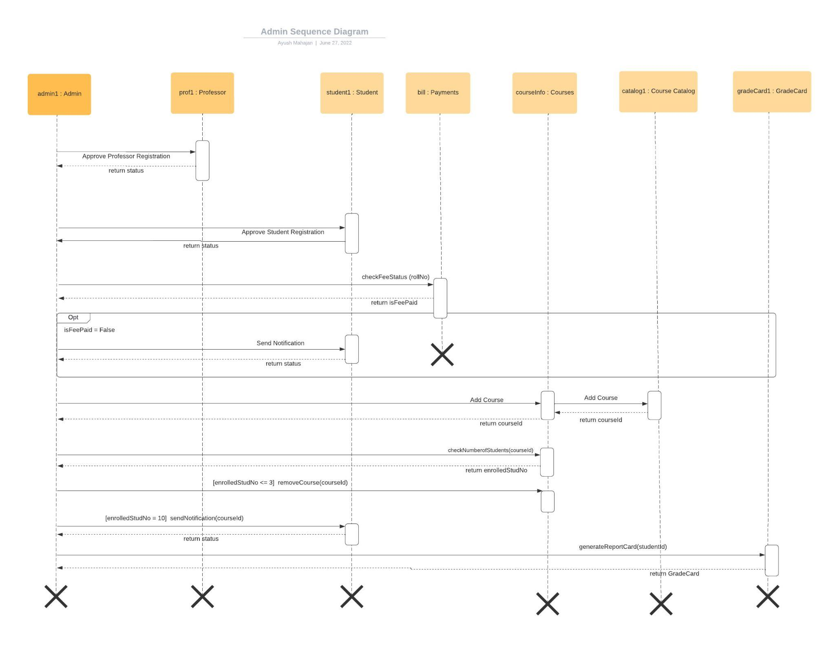

Slide 26
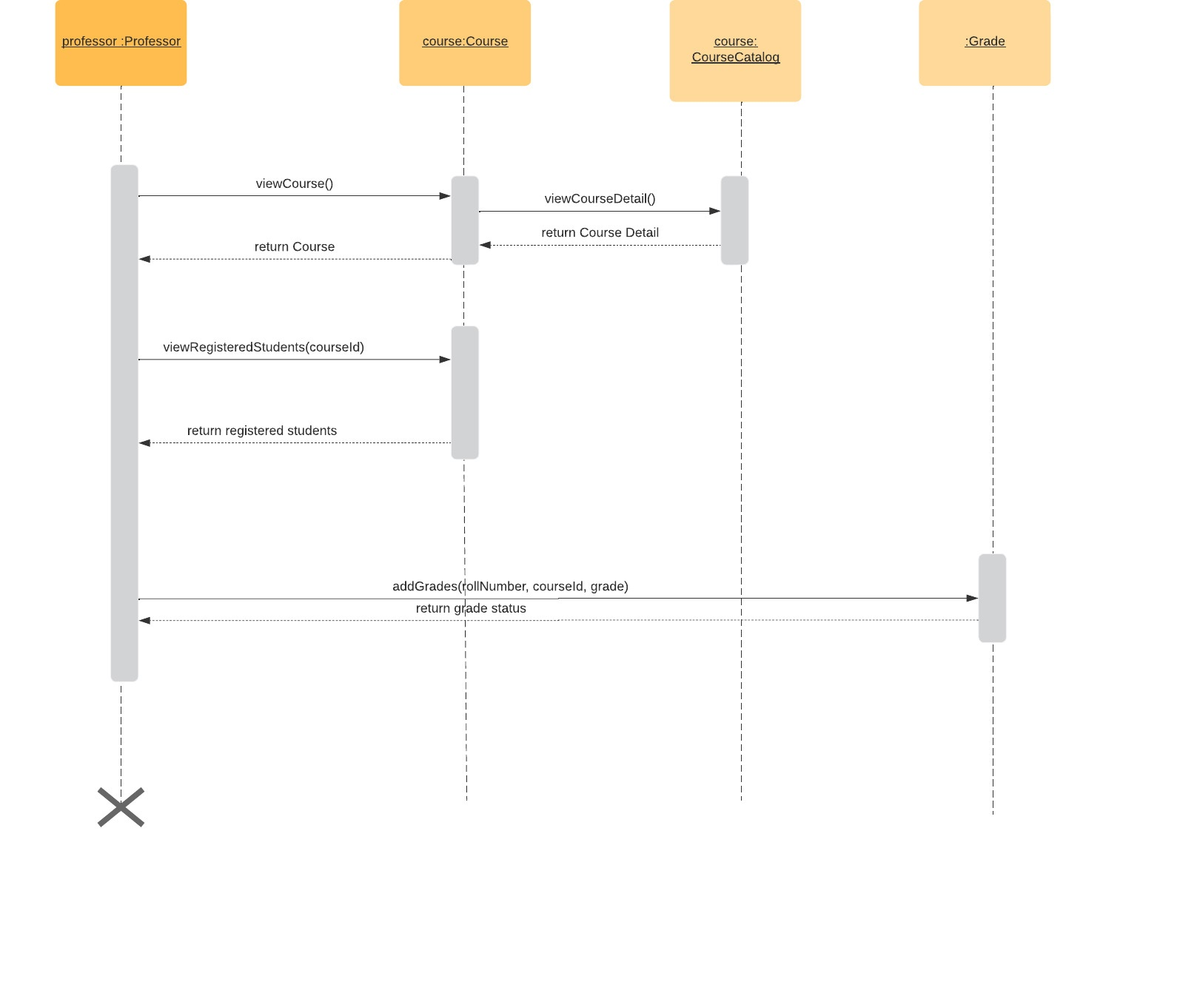

Slide 27
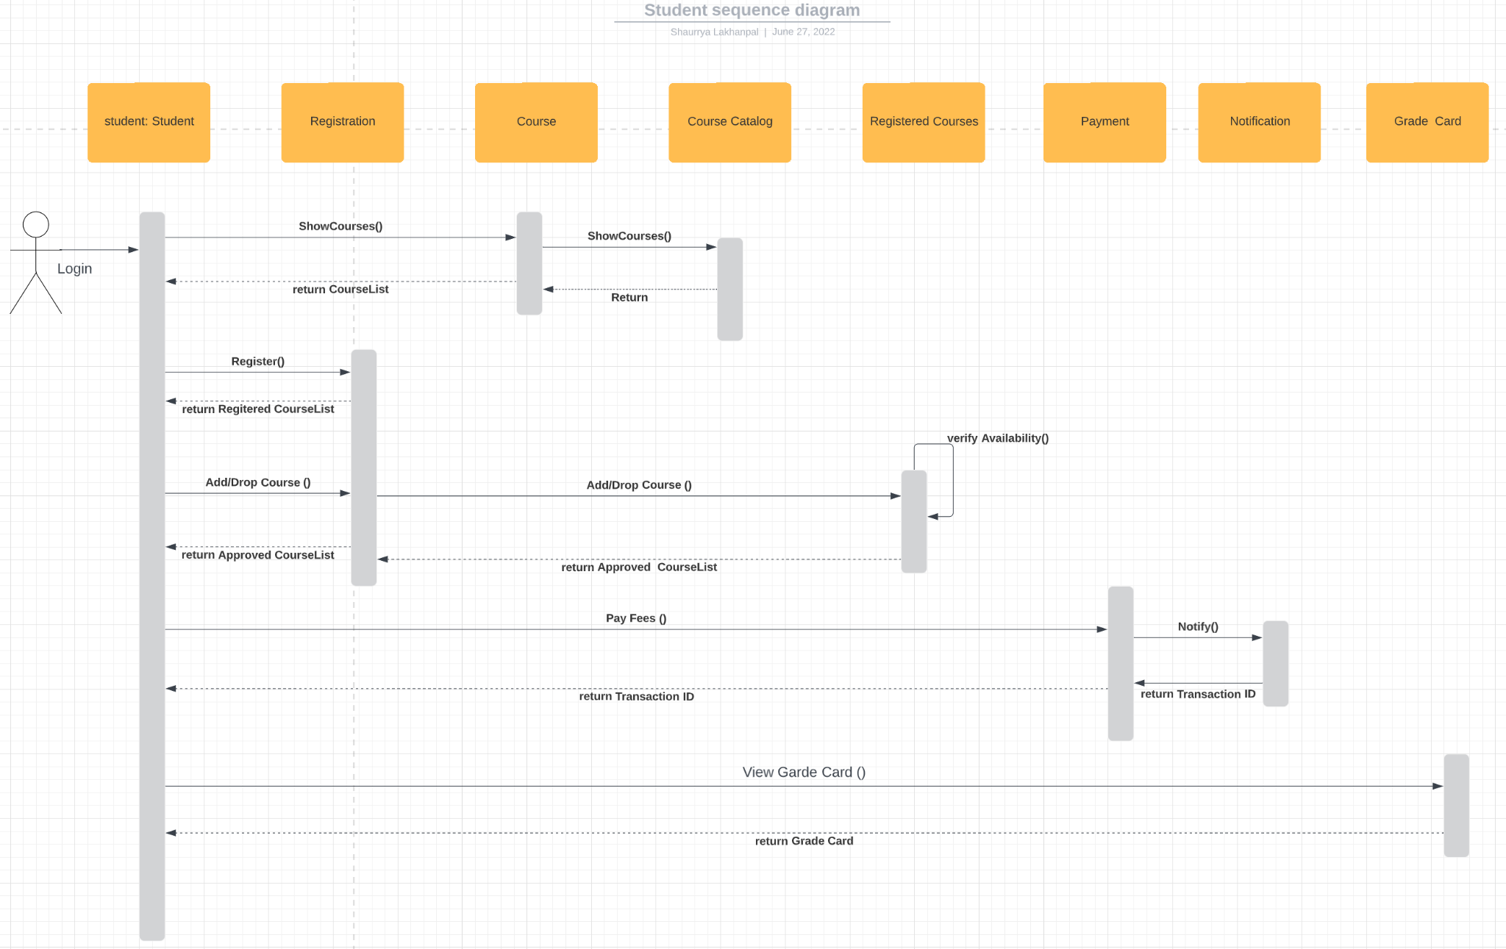

Slide 28
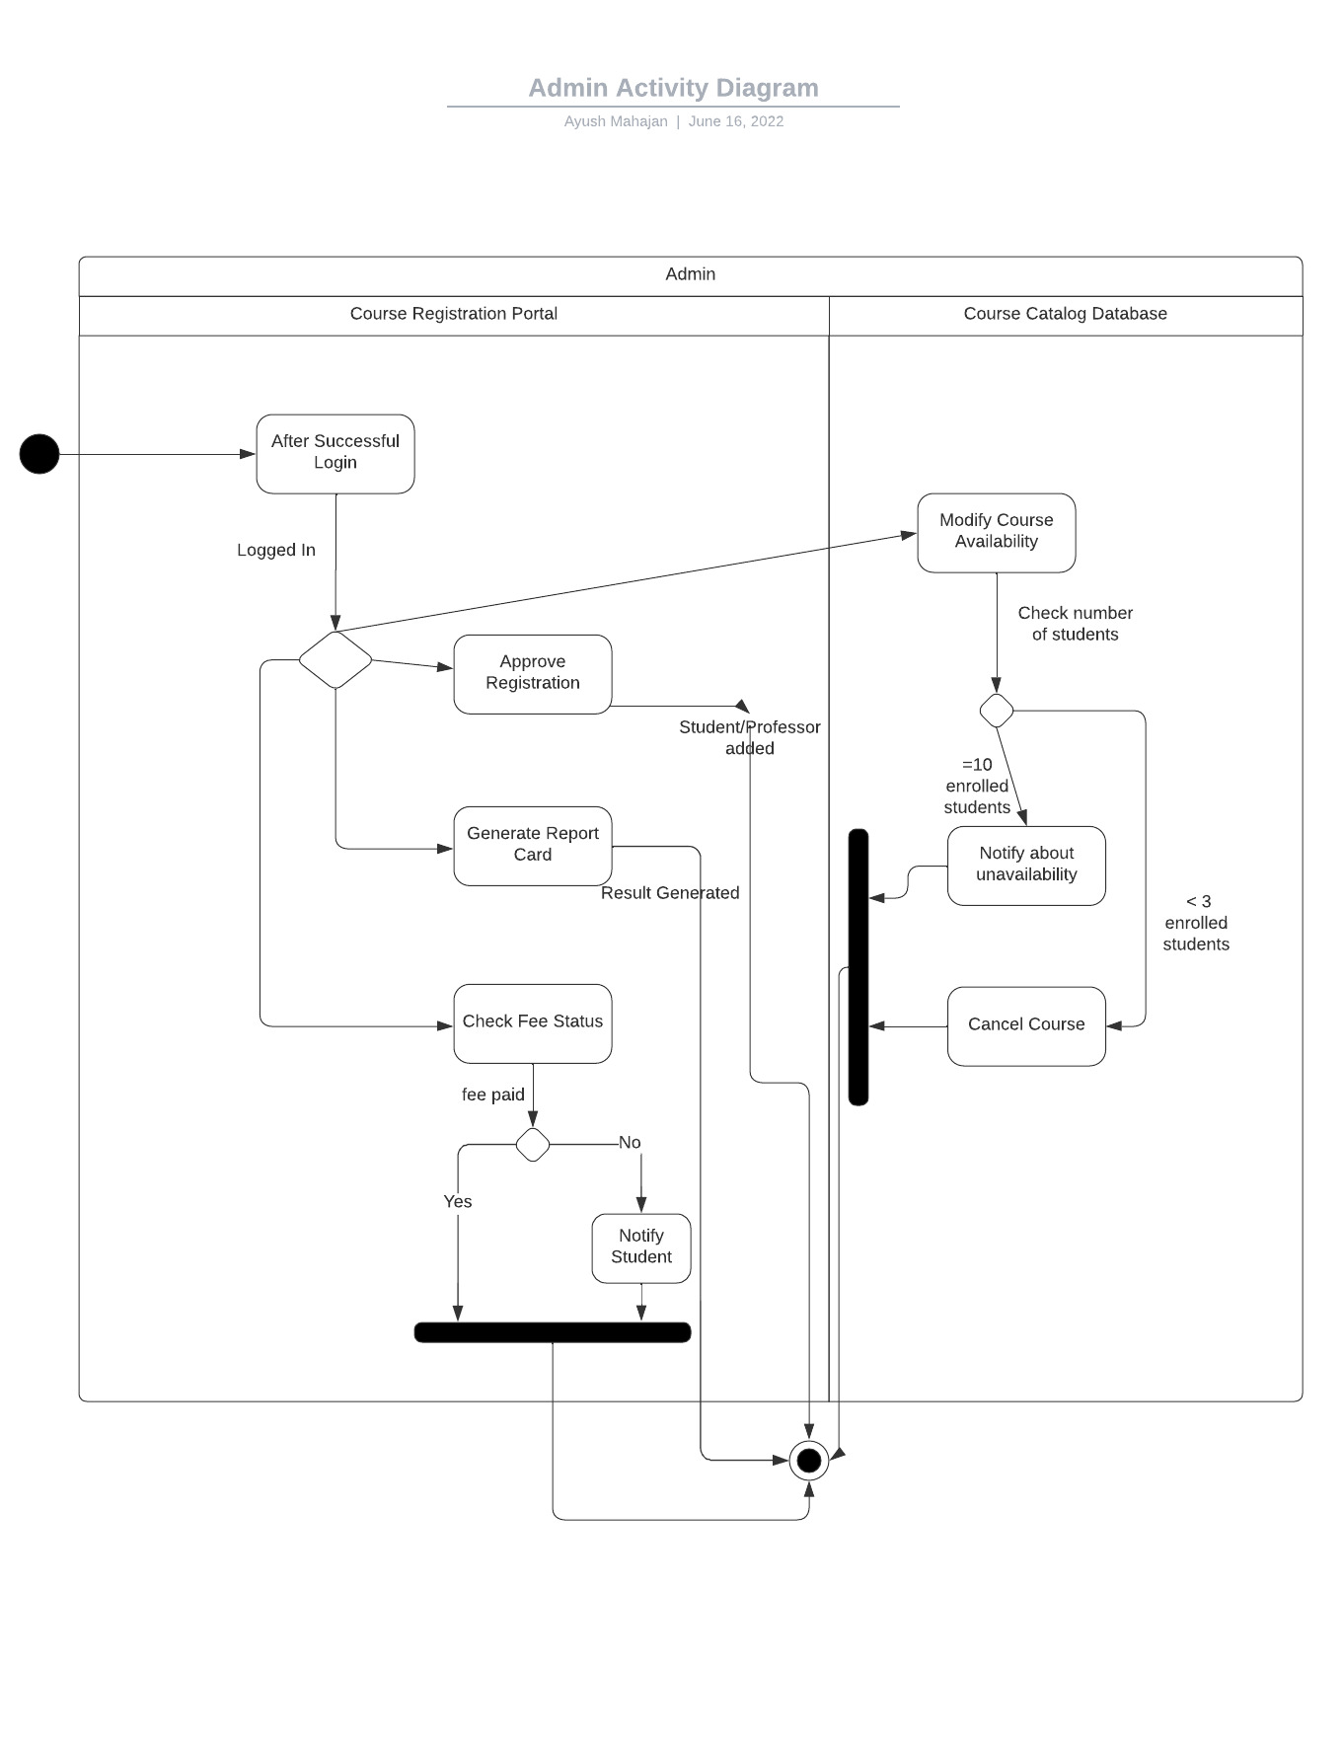

Slide 29
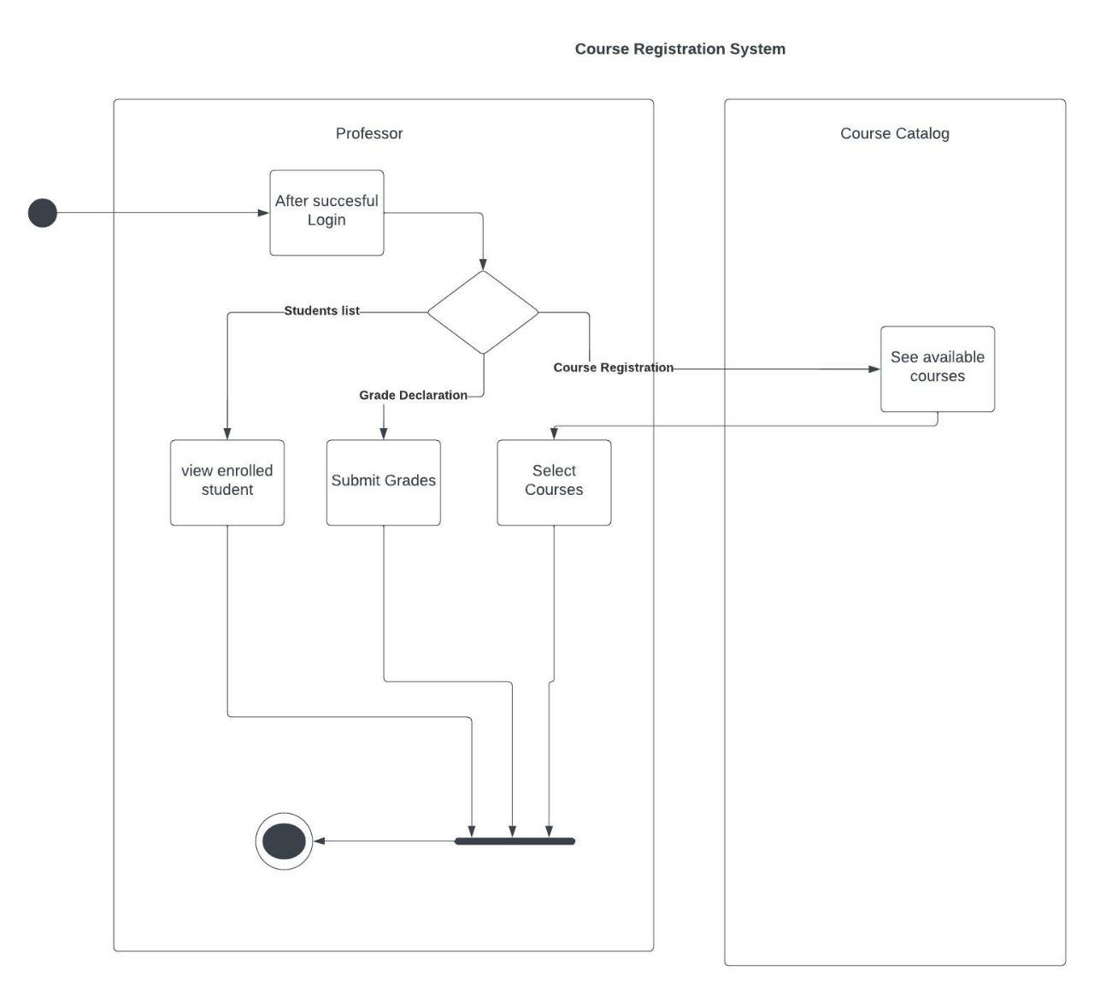

Slide 30
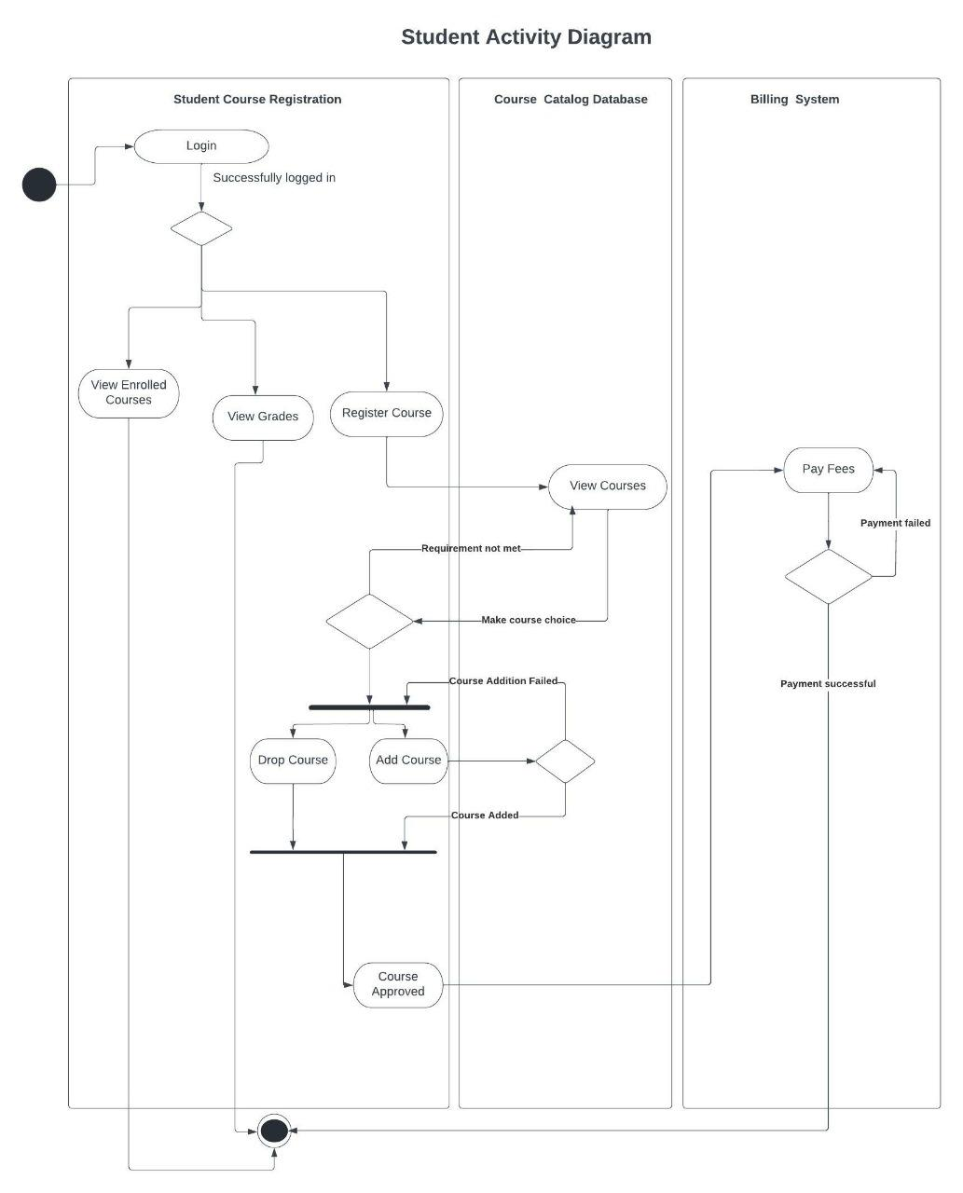

Slide 31

Demo
POS
Dropwizard
Git Repo Link- https://github.com/prachibajpai01/CRS-Flipkart-REPO-Group7
Notes:
Time –
Architecture – 5 mins
NFR Dashboard – 3 mins
Demo – 10 mins
1. Show the Responsiveness and Wave tool first

Slide 32
Thank you
(“THANK YOU”);
Notes:
Time – After this show the testimonial video. 1 min

